Slide 1

DEPARTMENT OF ARTIFICIAL INTELLIGENCE AND DATA SCIENCE
Vision
To impart international quality education, promote collaborative research and graduate industry-ready engineers in the domain of Artificial Intelligence and Data Science to serve the society.

Slide 2
Class
It is a abstract data type
Classes are used to create user-defined data structures
Class is a logical entity that contains some attributes and methods
A class is a collection of objects.
A class contains the blueprints from which the objects are being created.

Slide 3
class Student:
# class attribute
name = ""
# Instance attribute
def __init__(self, name):
self.name = name
def displayname(self):
print("My name is {}".format(self.name))
# Object instantiation or creation
s1 = Student("Raja") # it execute constructor or init method automatically
# Accessing class methods
s1.displayname()
The __init__ method or constructor
The __init__ method is a constructors.
It is executed automatically when an object of a class is instantiated/created.
Self
self identifies the instance upon which a method is invoked

Slide 4
class Student:
# class attribute
attr1 = "RIT STUDENTS"
# Instance attribute
def __init__(self, name):
self.name = name
# Object instantiation
Student1 = Student("Raja")
Student2 = Student("Ramu")
# Accessing class attributes
print("Student1 is a {}".format(Student1.__class__.attr1))
print("Student2 is also a {}".format(Student2.__class__.attr1))
# Accessing instance attributes
print("Student1 name is {}".format(Student1.name))
print("Student2 name is {}".format(Student2.name))
Output
Student1 is a RIT STUDENTS
Student2 is also a RIT STUDENTS
Student1 name is Raja
Student2 name is Ramu

Slide 5
Practices
Create a class called car and its attributes are model and color. Create a function to display the car attributes.
2 Create a class called dog and its attribute is species. Create a function description() that returns a string displaying the name and age of the dog. Create a another function speak() has one parameter called sound that returns a string containing the dog’s name and the sound the dog makes.
3 Create a class called book and its attributes are title, quantity, author and price . Create a function display to print the book details.

Slide 6
class car():
# init method or constructor
def __init__(self, model, color):
self.model = model
self.color = color
def show(self):
print("Model is", self.model )
print("color is", self.color )
# both objects have different self which
# contain their attributes
audi = car("audi a4", "blue")
ferrari = car("ferrari 488", "green")
audi.show() # same output as car.show(audi)
ferrari.show() # same output as car.show(ferrari)

Slide 7
class Dog:
species = "Canis familiaris" # class variable
def __init__(self, name, age):
self.name = name # instance variable
self.age = age
# Instance method
def description(self):
return f"{self.name} is {self.age} years old"
# Another instance method
def speak(self, sound):
return f"{self.name} says {sound}“
# Object instantiation
d1 = Dog("Labrador", 9)
print(d1.description())
d2 = Dog(" Labrador ", 9)
print(d2.speak("wow"))
Output
Labrador is 9 years old
Labrador says wow

Slide 8
class Book:
def __init__(self, title, quantity, author, price):
self.title = title
self.quantity = quantity
self.author = author
self.price = price
def __repr__(self):
return f"Book: {self.title}, Quantity: {self.quantity}, Author:
{self.author}, Price: {self.price}"
book1 = Book('Book 1', 12, 'Author 1', 120)
book2 = Book('Book 2', 18, 'Author 2', 220)
book3 = Book('Book 3', 28, 'Author 3', 320)
print(book1)
print(book2)
print(book3)

Slide 9
practice
1. Create a class called ComplexNumber which contain two data called real and imaginary. Create a displaymethod to print the data. Delete the attribute , function and object.

Slide 10
class ComplexNumber:
def __init__(self, r=0, i=0):
self.real = r
self.imag = i
def display(self):
print(f'{self.real}+{self.imag}j')
# Create a new ComplexNumber object
cn. ComplexNumber()
cn. display() # what is the output
cn = ComplexNumber(2, 3)
# Output: 2+3j
cn. display()
del num1.imag
del ComplexNumber.display
del cn

Slide 11
class CreditCard:
"""A consumer credit card."""
def __init__(self, customer, bank, acnt, limit):
self._customer = customer
self._bank = bank
self._account = acnt
self._limit = limit
self._balance = 0

Slide 12
def get_customer(self):
"""Return name of the customer."""
return self._customer
def get_bank(self):
"""Return the bank's name."""
return self._bank
def get_account(self):
"""Return the card identifying number (typically stored as a string)."""
return self._account
def get_limit(self):
"""Return current credit limit."""
return self._limit
def get_balance(self):
"""Return current balance."""
return self._balance

Slide 13
def charge(self, price):
"""Charge given price to the card, assuming sufficient credit limit.
Return True if charge was processed; False if charge was denied.
"""
if price + self._balance > self._limit: # if charge would exceed limit,
return False # cannot accept charge
else:
self._balance += price
return True
def make_payment(self, amount):
"""Process customer payment that reduces balance."""
self._balance -= amount

Slide 14
if __name__ == '__main__':
wallet = []
wallet.append(CreditCard('John Bowman', 'California Savings',
'5391 0375 9387 5309', 2500) )
wallet.append(CreditCard('John Bowman', 'California Federal',
'3485 0399 3395 1954', 3500) )
wallet.append(CreditCard('John Bowman', 'California Finance',
'5391 0375 9387 5309', 5000) )
for val in range(1, 17):
wallet[0].charge(val)
wallet[1].charge(2*val)
wallet[2].charge(3*val)

Slide 15
for c in range(3):
print('Customer =', wallet[c].get_customer())
print('Bank =', wallet[c].get_bank())
print('Account =', wallet[c].get_account())
print('Limit =', wallet[c].get_limit())
print('Balance =', wallet[c].get_balance())
while wallet[c].get_balance() > 100:
wallet[c].make_payment(100)
print('New balance =', wallet[c].get_balance())
print()

Slide 16
Iterator
An iterator is an object that consist of the methods __iter__() and __next__(). Iterator can be iterated
mytuple = ("apple", "banana", "cherry") myit = iter(mytuple) print(next(myit)) print(next(myit)) print(next(myit))

Slide 17
class SequenceIterator:
"""An iterator for any of Python's sequence types."""
def __init__(self, sequence):
"""Create an iterator for the given sequence."""
self._seq = sequence # keep a reference to the underlying data
self._k = -1 # will increment to 0 on first call to next
def __next__(self):
"""Return the next element, or else raise StopIteration error."""
self._k += 1 # advance to next index
if self._k < len(self._seq):
return(self._seq[self._k]) # return the data element
else:
raise StopIteration() # there are no more elements
def __iter__(self):
"""By convention, an iterator must return itself as an iterator."""
return
mytuple = ("apple", "banana", "cherry")
myobj = SequenceIterator(mytuple)
print(next(myobj))
print(next(myobj))

Slide 18
Operator overloading
Operator Overloading means giving additional meaning beyond their predefined operational meaning.
For example operator +
is used to add two integers as well as
join two strings and
merge two lists.
It is achievable because ‘+’ operator is overloaded by int class and str class.

Slide 19
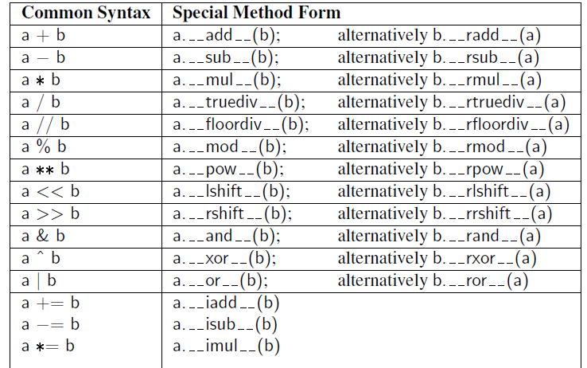

Slide 20
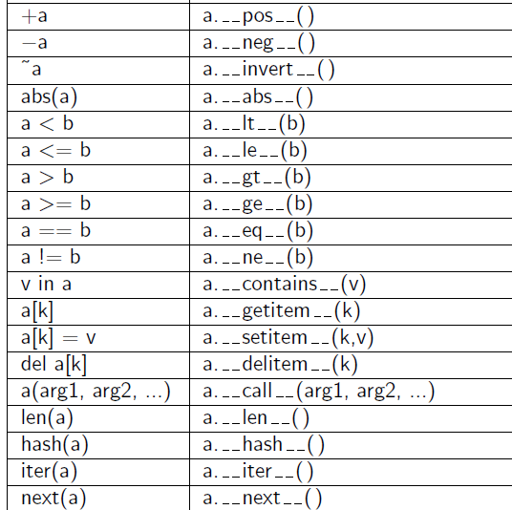

Slide 21
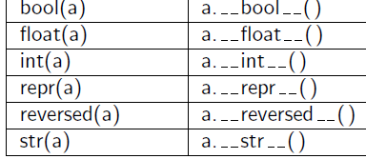

Slide 22
#operator overloading
print(1 + 2)
# concatenate two strings
print("RIT"+"IANS")
# Product two numbers
print(3 * 4)
# Repeat the String
print("RIT"*4)

Slide 23
# Python Program to overload an binary + operator
class A:
def __init__(self, a):
self.a = a
# adding two objects
def __add__(self, o):
return self.a + o.a
ob1 = A(1)
ob2 = A(2)
ob3 = A(“RIT")
ob4 = A(“IANS")
print(ob1 + ob2) # output ?
print(ob3 + ob4) # output ?

Slide 24
Python Program to perform addition of two complex numbers using binary + operator overloading.
class Complex:
def __init__(self, real, imaginary):
self. real = real
self. imaginary = imaginary
# adding two objects by operator overloading method
def __add__(self, other):
return self. real + other. real, self. imaginary + other. imaginary
Ob1 = complex(1, 2)
Ob2 = complex(2, 3)
Ob3 = Ob1 + Ob2
print(Ob3)

Slide 25
# Python program to overload a comparison operators
class A:
def __init__(self, a):
self.a = a
def __gt__(self, other):
if(self.a>other.a):
return True
else:
return False
ob1 = A(2)
ob2 = A(3)
if(ob1>ob2):
print("ob1 is greater than ob2")
else:
print("ob2 is greater than ob1")

Slide 26
Practice
Python program to overload equality and less than operators
Python program to overload not equality and greater than operators

Slide 27
Polymorphism
polymorphism means the same function name (but different signatures) being used for different types
def add(x, y):
return x + y
def add(x, y, z ):
return x + y+z
# Driver code
print(add(2, 3))
print(add(2, 3, 4))

Slide 28
Polymorphism
# Python program to demonstrate in-built polymorphic functions
# len() being used for a string
print(len("geeks"))
# len() being used for a list
print(len([10, 20, 30]))

Slide 29
Polymorphism
Polymorphism with class methods
class India():
def capital(self):
print("New Delhi is the capital of India.")
def language(self):
print("Hindi is the most widely spoken language of India.")
def type(self):
print("India is a developing country.")

Slide 30
Polymorphism
class USA():
def capital(self):
print("Washington, D.C. is the capital of USA.")
def language(self):
print("English is the primary language of USA.")
def type(self):
print("USA is a developed country.")
obj_ind = India()
obj_usa = USA()
for country in (obj_ind, obj_usa):
country.capital()
country.language()
country.type()

Slide 31
Practice
Practice
Implement polymorphism to find the area of circle, square, and rectangle.
Create the two classes ‘Tomato’ and ‘Apple’ which contains the methods type() and color(), each of which is print the type and color of the tomato and apple.

Slide 32
class Tomato(): #tomato class
def type(self):
print(" Tomato is a Vegetable")
def color(self):
print(“color is Red")
class Apple(): #apple class
def type(self):
print(“Apple is a Fruit")
def color(self):
print(“Apple is Red")
obj_tomato = Tomato()
obj_tomato.type()
obj_tomato.color()
obj_apple = Apple()
obj_apple.type()
obj_apple.color()

Slide 33
Inheritance

Slide 34
Polymorphism: Method Overriding or runtime polymorphism
The parent class and child class having the same method. This process of re-implementing a method in the child class is known as Method Overriding
class Bird:
def intro(self):
print("There are many types of birds.")
def flight(self):
print("Most of the birds can fly but some cannot.")
class sparrow(Bird):
def flight(self):
print("Sparrows can fly.")
class ostrich(Bird):
def flight(self):
print("Ostriches cannot fly.")

Slide 35
Polymorphism: Method Overriding or runtime polymorphism
obj_bird = Bird()
obj_spr = sparrow()
obj_ost = ostrich()
obj_bird.intro()
obj_bird.flight()
obj_spr.intro()
obj_spr.flight()
obj_ost.intro()
obj_ost.flight()

Slide 36
Multi-dimensional vector class
import collections
class Vector:
"""Represent a vector in a multidimensional space."""
def __init__(self, d):
if isinstance(d, int):
self._coords = [0] * d
else:
try: # we test if param is iterable
self._coords = [val for val in d]
except TypeError:
raise TypeError('invalid parameter type')

Slide 37
def __len__(self):
"""Return the dimension of the vector."""
return len(self._coords)
def __getitem__(self, j):
"""Return jth coordinate of vector."""
return self._coords[j]
def __setitem__(self, j, val):
"""Set jth coordinate of vector to given value."""
self._coords[j] = val

Slide 38
def __add__(self, other):
"""Return sum of two vectors."""
if len(self) != len(other): # relies on __len__ method
raise ValueError('dimensions must agree')
result = Vector(len(self)) # start with vector of zeros
for j in range(len(self)):
result[j] = self[j] + other[j]
return result
def __eq__(self, other):
"""Return True if vector has same coordinates as other."""
return self._coords == other._coords

Slide 39
def __ne__(self, other):
"""Return True if vector differs from other."""
return not self == other # rely on existing __eq__ definition
def __str__(self):
"""Produce string representation of vector."""
return '<' + str(self._coords)[1:-1] + '>' # adapt list representation
def __neg__(self):
"""Return copy of vector with all coordinates negated."""
result = Vector(len(self)) # start with vector of zeros
for j in range(len(self)):
result[j] = -self[j]
return result

Slide 40
def __lt__(self, other):
"""Compare vectors based on lexicographical order."""
if len(self) != len(other):
raise ValueError('dimensions must agree')
return self._coords < other._coords
def __le__(self, other):
"""Compare vectors based on lexicographical order."""
if len(self) != len(other):
raise ValueError('dimensions must agree')
return self._coords <= other._coords

Slide 41
if __name__ == '__main__':
# the following demonstrates usage of a few methods
v = Vector(5) # construct five-dimensional <0, 0, 0, 0, 0>
v[1] = 23 # <0, 23, 0, 0, 0> (based on use of __setitem__)
v[-1] = 45 # <0, 23, 0, 0, 45> (also via __setitem__)
print(v[4]) # print 45 (via __getitem__)
u = v + v # <0, 46, 0, 0, 90> (via __add__)
print(u) # print <0, 46, 0, 0, 90>
total = 0
for entry in v: # implicit iteration via __len__ and __getitem__
total += entry
Output
45
<0, 46, 0, 0, 90>

Slide 42
References
https://www.geeksforgeeks.org/python-oops-concepts/

